Slide 1



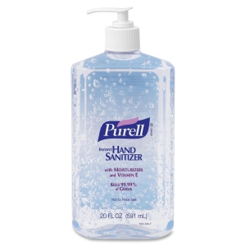
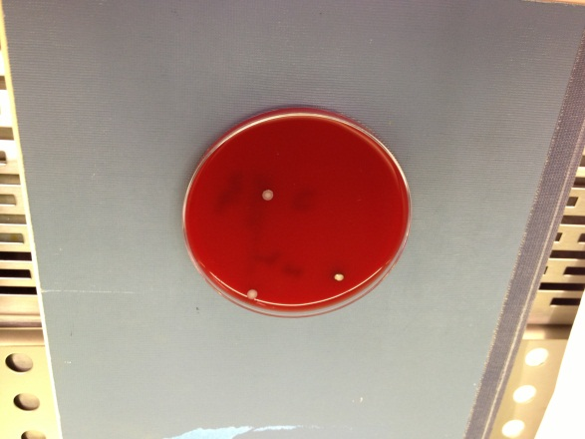
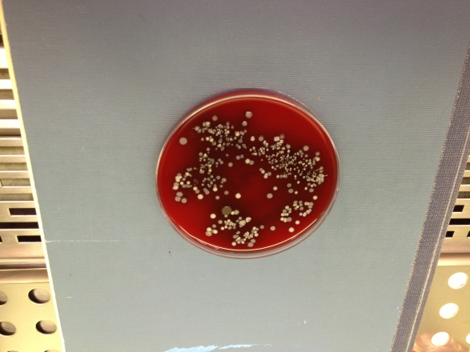
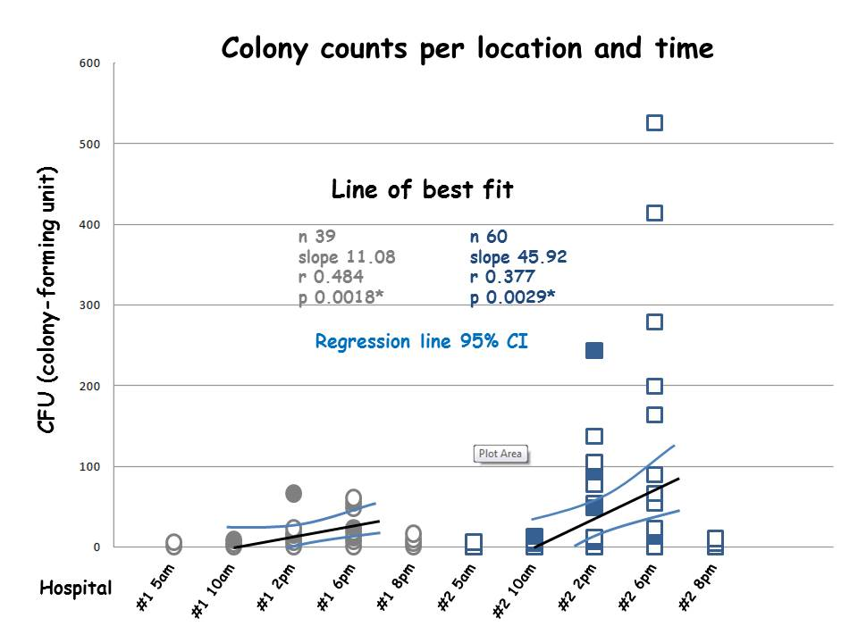
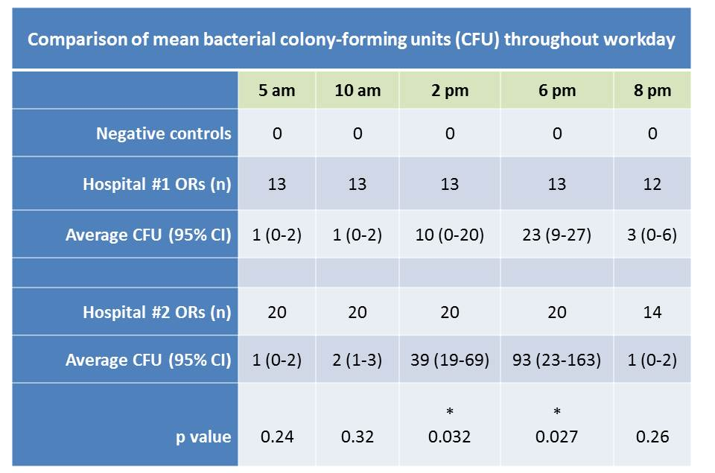

Another Source to Stymie: Hand Sanitizer Dispenser: A Pilot Study Improving Anesthesia Workplace Hygiene
Devon Cole, MD, Sadiq Shaik, MD, Nikolaus Gravenstein, MD
Department of Anesthesiology, University of Florida College of Medicine, Gainesville
Annual Meeting
2013
Background
Methods
Results
Conclusion
We hypothesized that decontamination of hand sanitizer dispensers (HSDs) would reduce the bacterial burden throughout the anesthesia workday. The goal of this study was to quantify HSD bacterial burden and to determine if interval HSD disinfection by antibacterial wipe is effective.
Poor anesthesia provider hand hygiene has been associated with increased patient mortality through direct transmission of bacterial to open-lumen, three-way stopcock sets used during
HSDs located at anesthesia workstations for hospital #1 (13 ORs) and hospital #2 (20 ORs) were compared. At hospital #1, we instituted a protocol to have all surfaces of HSDs cleaned between case OR room turnover, using Sani-Cloth Germicidal Disposable Wipes (PDI, Orangeburg, NY) to disinfect (example A) the counter-top HSD gel pump bottle (Purell®, Akron, OH) located at each anesthesia workstation. At hospital #2, no disinfection of HSD was instituted at anesthesia workstations.
Sterile 4 × 4s moistened with 5 mL of sterile saline were used to swab the top of each HSD handle at 4-h intervals, and were then spread evenly on sheep blood agar plates (R01198; Remel, Lenexa, KS) and cultured at 37°C for 48 h. Negative control samples for each time interval were sterile 4 × 4s and saline alone. Total colony-forming units (CFUs) were counted (examples B and C) and statistical analysis was done using Excel (ver. 2010, Microsoft, Redmond, WA), unequal variance for t test, and linear regression.
HSDs accumulate a rising bacterial burden throughout the workday from 10 am to 6 pm, showing a strong linear relationship: hospital #1, p = 0.0018 and hospital #2, p = 0.0029 (Figure 1). A total of 163 samples was collected (Table 1). The desiccant effect is evident at time points 5 am and 8 pm where the HSDs sampled were not used for greater than 120 minutes, with no significant difference in CFUs detected when comparing hospitals #1 and #2. At the beginning of the workday, no difference between hospitals #1 and #2 was seen at 10 am, p = 0.32. The disinfection strategy of interval clean disposable microbicidal wiping at hospital #1 of HSDs is effective at time points 2 pm, p = 0.032 and 6 pm, p = 0.027.
Lack of good hand hygiene is associated with postoperative infections through direct transmission of bacterial contaminants to IV tubing stopcocks (1)
Overwhelming evidence shows that enhanced environmental cleaning and disinfection of high-touch surfaces reduces transmission of pathogens (3)
Epidemiologic investigation with laboratory confirmation identifies practice improvement changes that result in relevant interventions (4)
Many inanimate objects in the hospital setting are reservoirs for pathogens with matching genetic profiles identical to those found in patients (5)
The HSD at the anesthesia workstation is an easily overlooked high-touch surface that becomes a potential pathogen vector during the course of the OR workday. Cleaning them with a microbicidal wipe during room turnover measurably reduces the HSD bacterial burden during the workday and is an easily implemented practice to add to the routine OR workstation turnover process.
anesthesia in the operating room (1). HSDs are known to become contaminated by high touch use with pathogens that may cause hospital-acquired infection (HAI). One study of HSDs yielded many bacterial species, including commensal skin flora and enteric gram-negative bacilli (2). Colonization was greatest on the lever, where there was direct hand contact.
A
B
C
References
Loftus, et al. Reduction in intraoperative bacterial contamination of peripheral intravenous tubing through the use of a passive catheter care system. Anesth Analg 2012 Dec;115:1315-23
Eiref, et al. Hand sanitizer dispensers and associated hospital-acquired infections: friend or fomite? Surg Infect 2012;13:137-40
Donskey CJ. Does improving surface cleaning and disinfection reduce health care-associated infections? Am J Infect Control 2013
Kollef M. SMART approaches for reducing nosocomial infections in the ICU. Chest 2008 Aug; 134:447-56
Vallés, et al. Patterns of colonization by Pseudomonas aeruginosa in intubated patients: a 3-year prospective study of 1,607 isolates using pulsed-field gel electrophoresis with implications for prevention of ventilator-associated pneumonia. Intensive Care Med 2004 Sep;30:1768-75
Figure 1
Comparison of HSD handle bacteria burden throughout the workday at anesthesia workstations, hospital #1 (interval cleaning) versus hospital #2 (no interval cleaning).
Table 1
Comparison of HSD handle bacteria burden throughout the workday at anesthesia workstations. Disinfection of HSDs is effective with disposable wipes at time points 2 pm, p = 0.032 and 6 pm, p = 0.027.

